Slide 1
Presentation on Cloud Computing Projects
Presented by
Shreya Nigam(Team Lead)
Shivangi
Varchasw Tripathi

Slide 2
Project 1 Automated Image Processing with AWS Lambda and S3

Slide 3
Introduction
We will present how to automate image resizing using AWS S3 (Simple Storage Service) , Lambda(serverless compute) and SNS (Simple Notification Service) enabling efficient image management and delivery

Slide 4
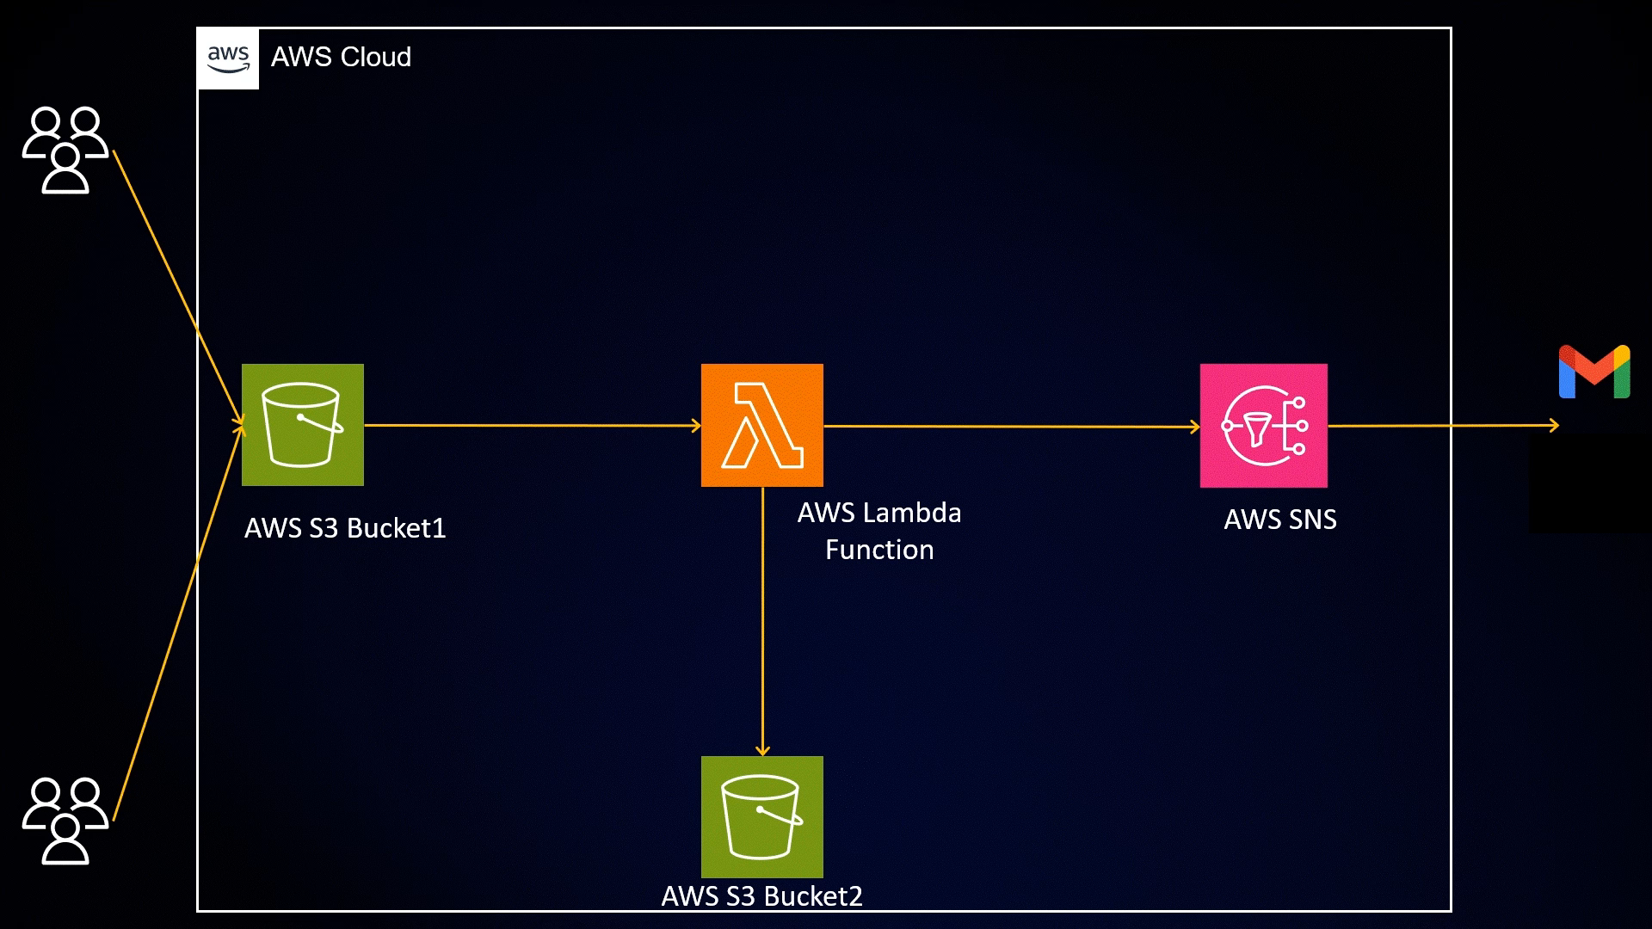
Architecture

Slide 5

Simple Storage Service (S3)
In our Serverless Image Processing Application, Amazon S3 plays a crucial role as the storage foundation for the image that we are processing.
Amazon S3 serves as the storage repository for all the image uploaded in our application. When we upload images they are stored as objects within S3 Buckets.

Slide 6

Lambda
In our serverless image processing application, AWS Lambda take son the role of automated image processing engine. AWS Lambda hosts the code that performs the image processing, such as resizing and optimizing. The code is written in Python, Node.js, etc.

Slide 7

Simple Notification Service
Amazon SNS serves as a important communication tool in our serverless image processing application. It helps us stay informed, react to events and maintain smooth and well monitored image processing workflow, ensuring that our application remains efficient and effective.

Slide 8
Workflow
In this project, we will be creating two buckets. The first bucket will be used to store the original images that we want to resize. The second bucket will be dedicated to storing the resized image.
After that we created a SNS Topic and SNS Subscription and gave the Protocol type as Email. Then we confirmed the subscription to get the notification for the resized image.

Slide 9
After these steps we created Lambda Function that helped us to resize the image and store the images. While creating Lambda Function we chose runtime as Python 3.9 and for the role we selected first option i.e. Create a new role with basic lambda permissions.
We replaced the code by uploading Python code’s zip file and deployed it. We then changed the handler name, added environment variables for SNS and S3 bucket , added a PIL Layer. We then provided with the permission of S3FullAccess and SNSFullAccess to the role that was created earlier.
We added a Trigger for the Lambda function. So whenever someone uploads an image to Bucket1. The lambda function will trigger and start the process of resizing the image.

Slide 10
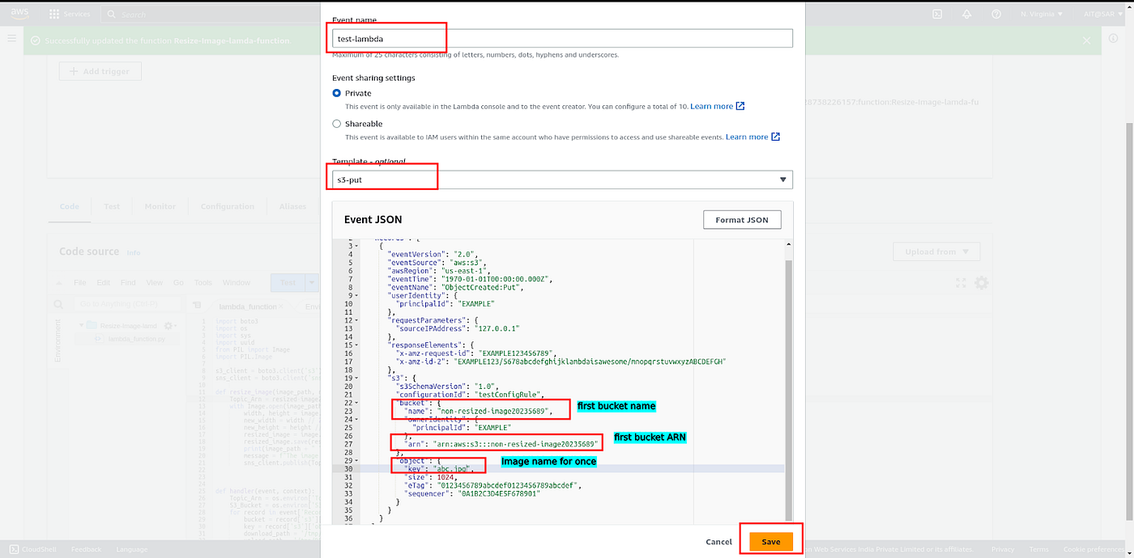
As we configured all the things related to Lambda Function, we tested it by configuring a test event and Template as S3-put.

Slide 11
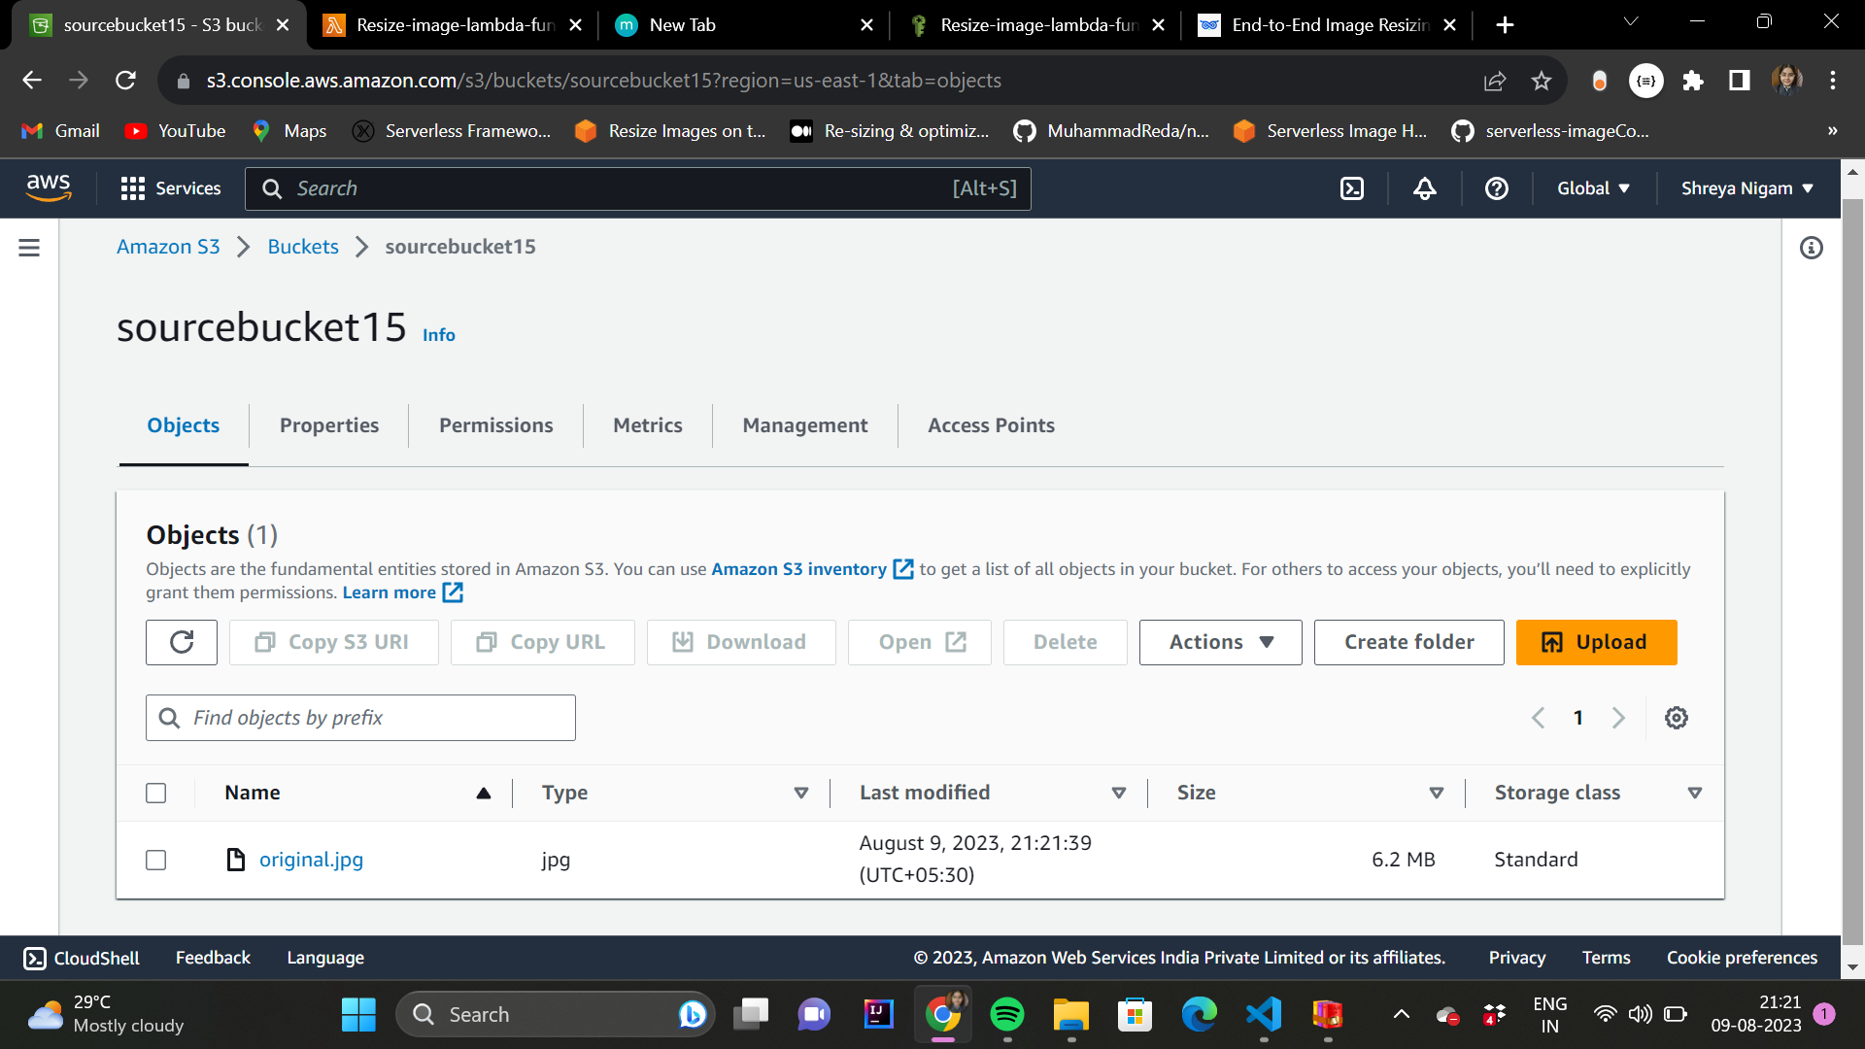
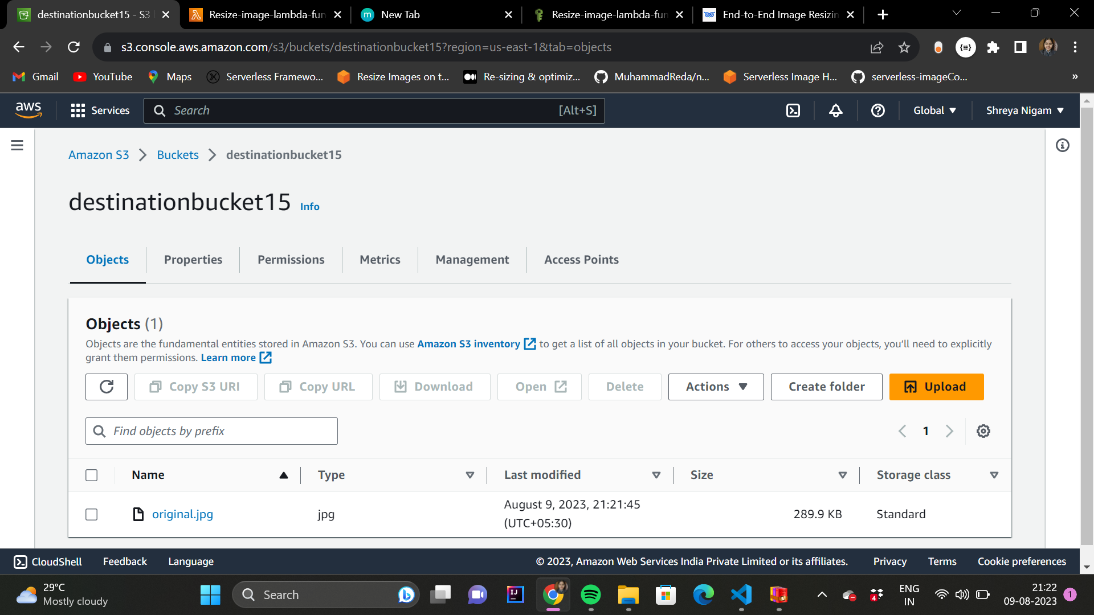
Finally we uploaded an image to Bucket1.
The image has been resized automatically and is uploaded to Bucket2.

Slide 12
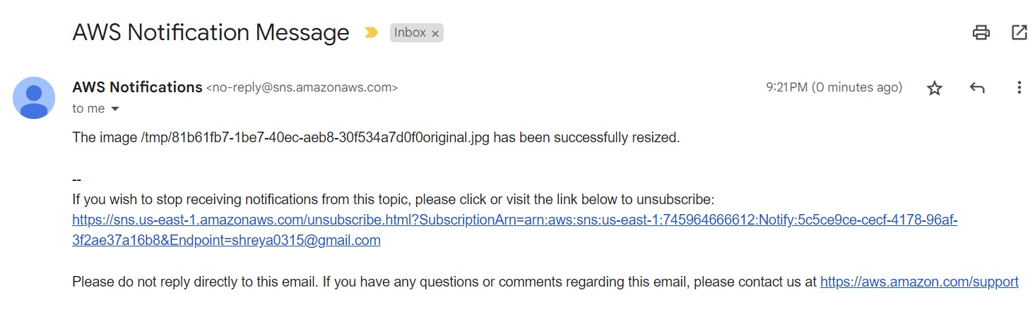
We have received the mail through SNS notification service.
In conclusion, we have successfully implemented an automated image resizing system using AWS S3, Lambda, and SNS. This solution allows us to store the original images in one bucket and automatically resize and store them in another bucket.

Slide 13
PROJECT 2
Creating and deploying static website with aws s3

Slide 14
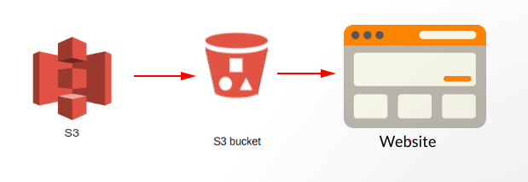
ARCHITECTURE

Slide 15
WORKFLOW
We created a S3 bucket and unchecked the option of Block all public access.
Enabled Static Website Hosting for our S3 Bucket, configured it to use index.html. And copied the endpoint provided in the Static Website Hosting Section.
We then uploaded all the Files (index.html, styles.css and JavaScript file) of our website into S3 Bucket and added a bucket policy to the bucket.
Now, we pasted the endpoint we copied earlier into our browser.
Now we will be able to see our Static Website Hosted successfully.

Slide 16
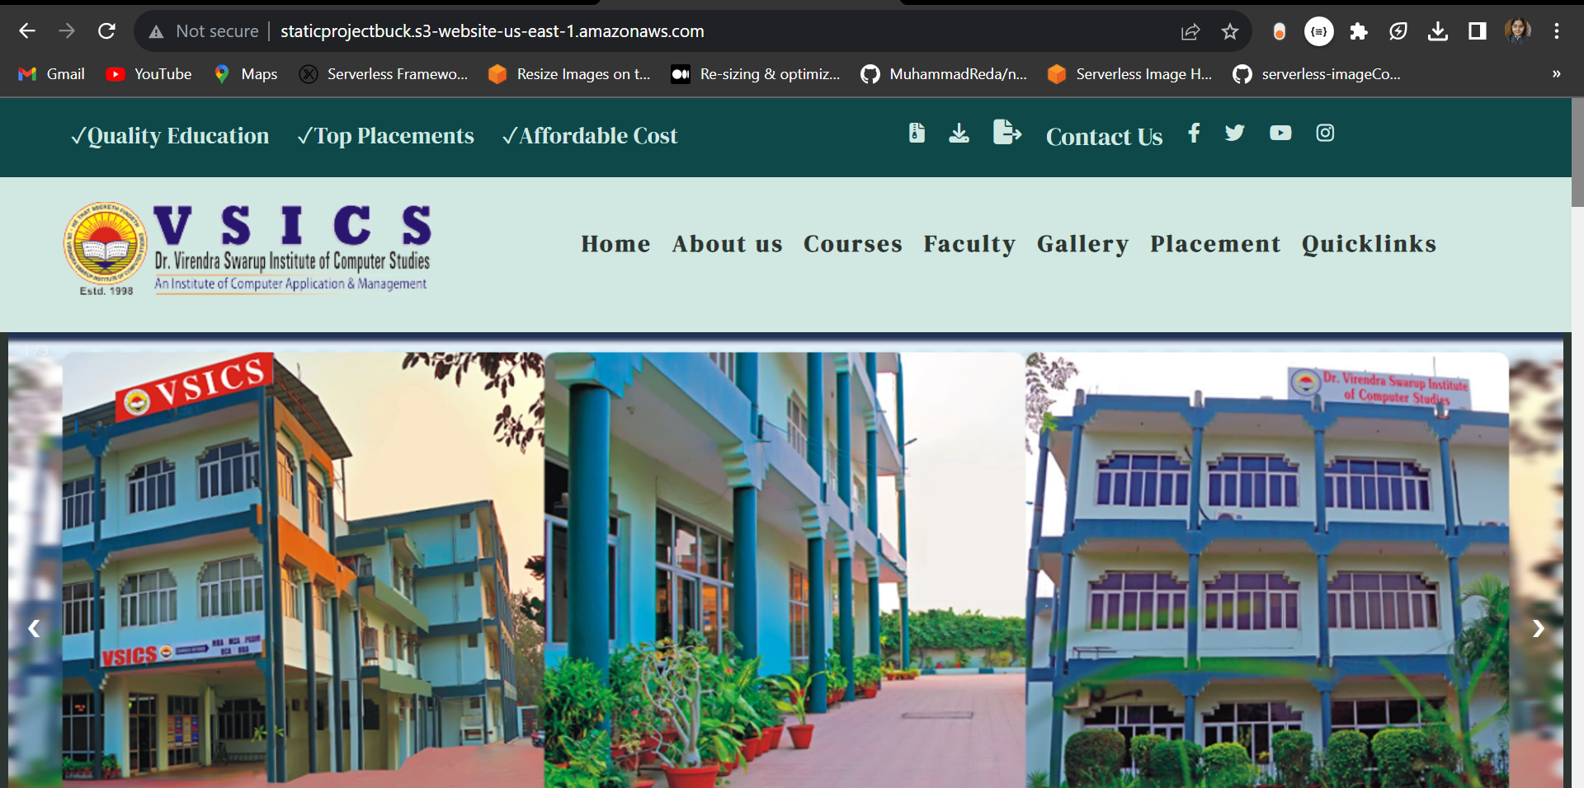

Slide 17
Thank You

